Slide 1

Basic Details of the Team and Problem Statement
2023
Ministry/Organization Name/Student Innovation: Ministry of Defence
PS Code: 1416
Problem Statement Title: AI based Automatic alarm generation and dropping of payload at a particular object through a Drone.
Team Name: MILVUS MIGRANS
Team Leader Name: Rayavarapu Devi Sri Valli
Institute Code (AISHE): 1-36960211636.
Institute Name: SRKR ENGINEERING COLLEGE
Theme Name: Disaster Management

Slide 2
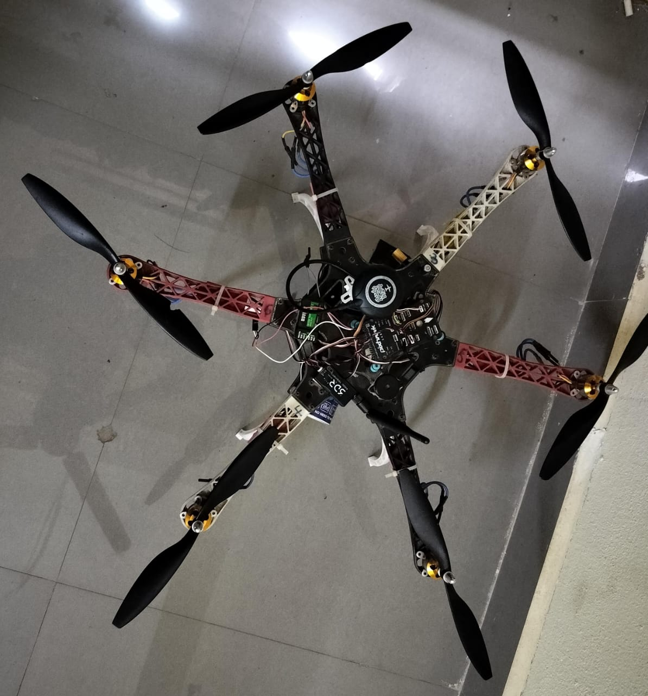
Idea/Approach Details
IMAGES
DRONE
idea/Solution/Prototype here:
the Drones with artificial intelligence based automatic object recognition capability can help rescue teams a lot through automatic alarm generation and dropping of payloads like food, clothes, rescue tools near detected human being
The proposed methodology for this advanced drone-based disaster response system encompasses a multi-faceted approach to address the challenges posed by severe earthquakes and floods .
a precise payload dropping mechanism will be designed to ensure targeted and reliable delivery of essential supplies to identified individuals
This algorithm will be rigorously trained and optimized for real-time processing and accuracy, even in adverse environmental conditions
Enhance the system's localization capabilities, leveraging GPS and other technologies to achieve precise positioning for accurate payload delivery.
Ensure compatibility with existing disaster response infrastructure and networks, facilitating seamless collaboration with other response teams and agencies
Technology stack here:
CAMERA MODULE
RASPBERRY PI
IOT ( INTERNET OF THINGS )
AI AND ML
YOLO V3
ROS
AI /ML
GPS
AI BASED DRONE STARTUP / ITS MARKET SHARE/SCOPE OF STARTUP
AI-based drone startups are on the rise, and India is no exception. With government support and growing demand, these startups are poised to make a significant impact on the country's economy.
AI-based drone startups are playing a growing role in the global drone industry, with a market share that is expected to reach $7.5 billion by 2027. In India, the scope of AI-based drone startups is very promising, thanks to the government's support for the drone industry and the growing demand for drone services from businesses.

Slide 3
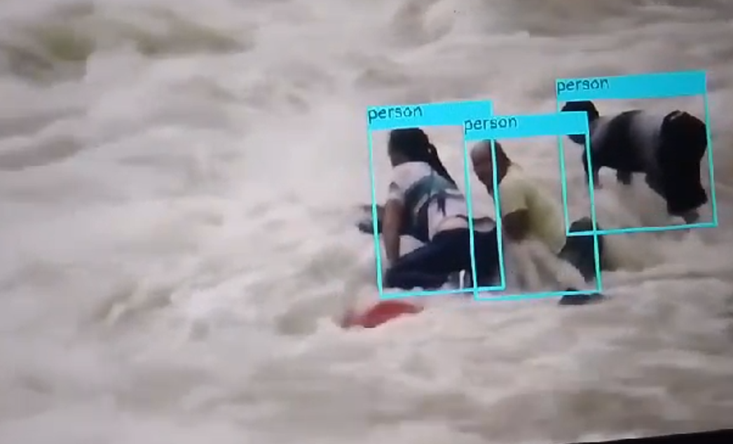
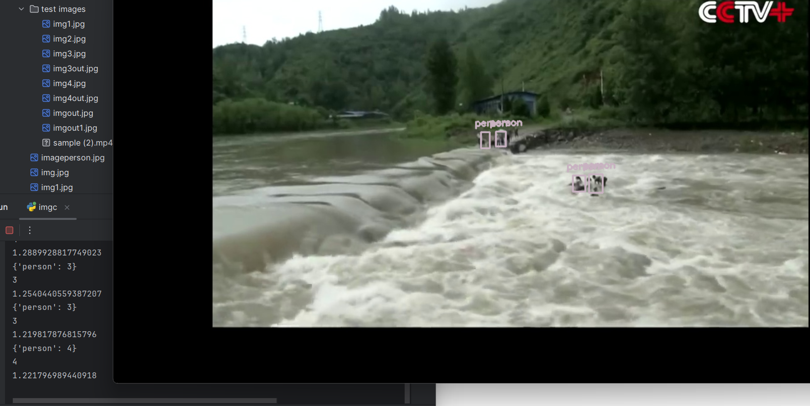
Idea/Approach Details
Use Cases here:
After an earthquake, drones swiftly locate and rescue trapped individuals using advanced object recognition.
In wildfires, drones deliver essential supplies to isolated areas, aiding emergency response efforts.
Military personnel benefit from reconnaissance drones, which locate and resupply troops in remote areas.
Medical supplies are swiftly delivered to emergencies in remote locations via drones.
Law enforcement agencies use drones for border control and surveillance in critical areas.
Drones aid in wildlife surveys and monitoring of endangered species in challenging terrains.
Drones enhance crowd management and public safety during large gatherings.
Dependencies / Show stopper :
FUTURE OF DRONES :
1.Camera Availability and Quality
2. Data Security and Compliance
3. IOT Connectivity and Stability
4. Government regulations
5. Technological breakthrough by a competitor
1. Drones could be used to create new forms of transportation.
2. Drones could be used to monitor environmental conditions and track climate change
3. Drones could be used to provide medical supplies and vaccines to remote areas

Slide 4
Team Member Details
Team Leader Name: Rayavarapu Devi Sri Valli
Branch : Btech Stream : EEE Year : 3
Team Member 1 Name: Bhargav
Branch : Btech Stream : MECH Year :4
Team Member 2 Name: PYLA ROHITH
Branch : Btech Stream : MECH Year : 3
Team Member 3 Name: TARAPATLA PREM KUMAR
Branch : Btech Stream : EEE Year : 2
Team Member 4 Name: Oruganti Naga Krishna Shreeya
Branch : Btech Stream : MECH Year : 4
Team Member 5 Name: LEKKALA HARSHA
Branch : Btech Stream :EEE Year : 4
Team Mentor 1 Name: Dr. Siva Rama Krishna
Category: Academic Expertise : EEE Domain Experience : 7
Team Mentor 1 Name: Rajasekhar Mutukuri
Category : Industry Expertise :ECE Domain Experience : 5

